Slide 1
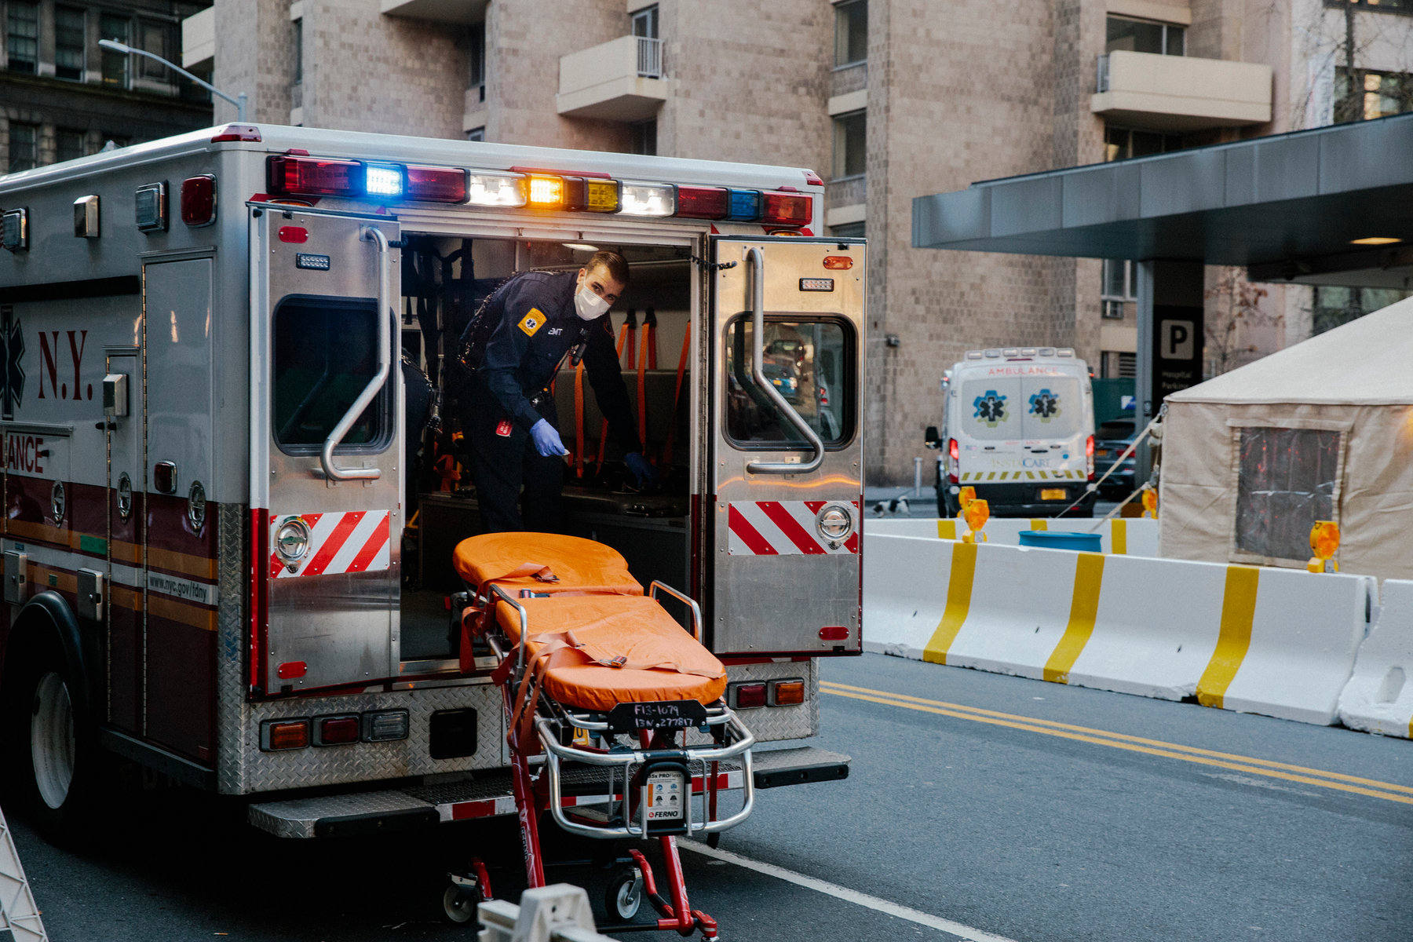
Jobs in My Town
Paramedic
Notes:
This Job…
Take emergency calls
Helps people when they are sick or hurt
Works with medicine
Drives a car with siren and lights

Slide 2
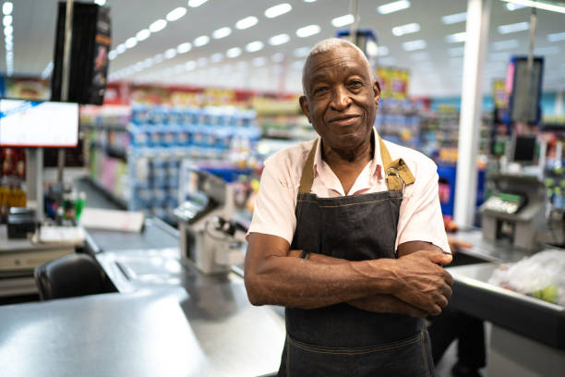
Jobs in My Town
Store Owner
Notes:
This Job…
Works with money such as dollars, coins, and credit cards.
This job works with food such as drinks and snacks.

Slide 3
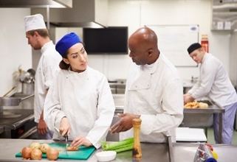
Jobs in My Town
Chef
Notes:
This Job…
Works on a team
Works with food
Works at a restaurant

Slide 4
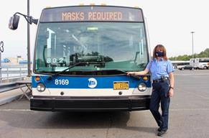
Jobs in My Town
Bus Driver
Notes:
This Job…
Works with money such as dollars, coins and cards.
Travels all over the city
Drives you to where you need to go

Slide 5
Jobs in My Town
Mechanic
Notes:
This Job…
Uses tools
Inspects your ca
fixes your car

Slide 6
Jobs in My Town
Nurse
Notes:
This Job…
Helps people when they are sick or hurt
Work with medicine
Give you a shot in your arm. OUCH!

Slide 7
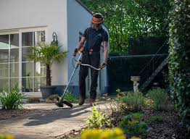
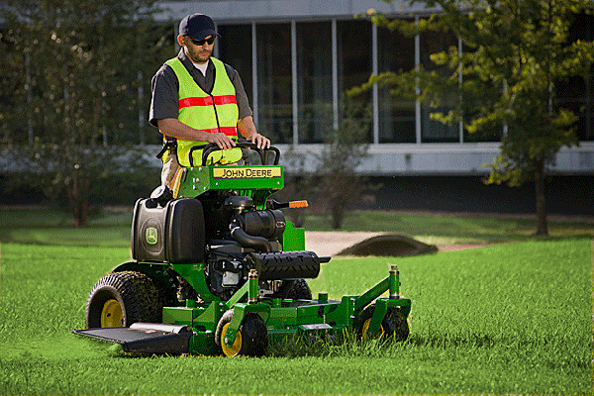
Jobs in My Town
Gardener
Notes:
This Job…
Works outside
Cuts grass
Plants flowers, grass, trees and more.

Slide 8
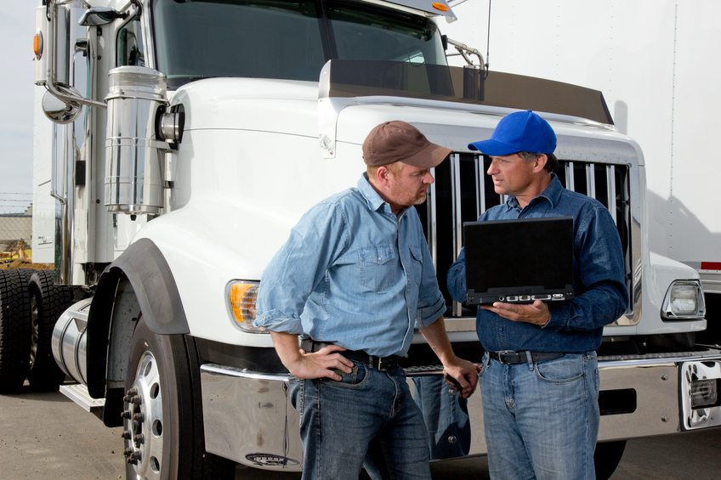
Jobs in My Town
Truck Driver
Notes:
This Job…
Drives a lot
Moves things from place to place.
Drives a BIG car

Slide 9
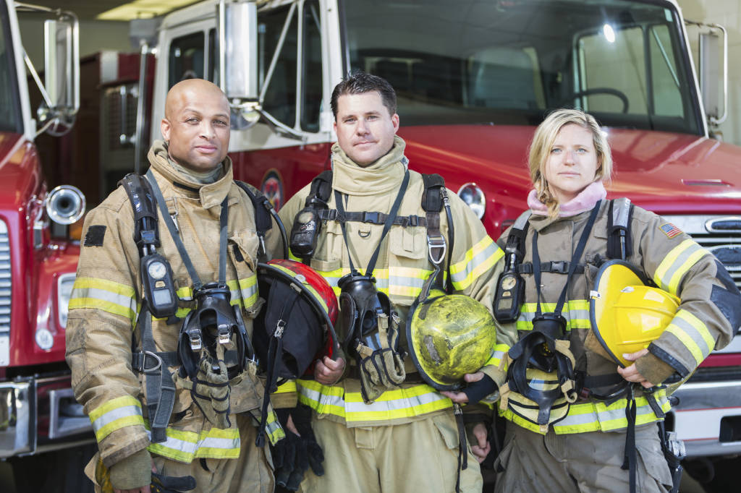
Jobs in My Town
Firefighter
Notes:
This Job…
Helps people
Drives a big truck with lights and a siren
Puts out fires

Slide 10
Jobs in My Town
Librarian
Notes:
This Job..
Helps people to research things
Works with computers
Works with books

Slide 11
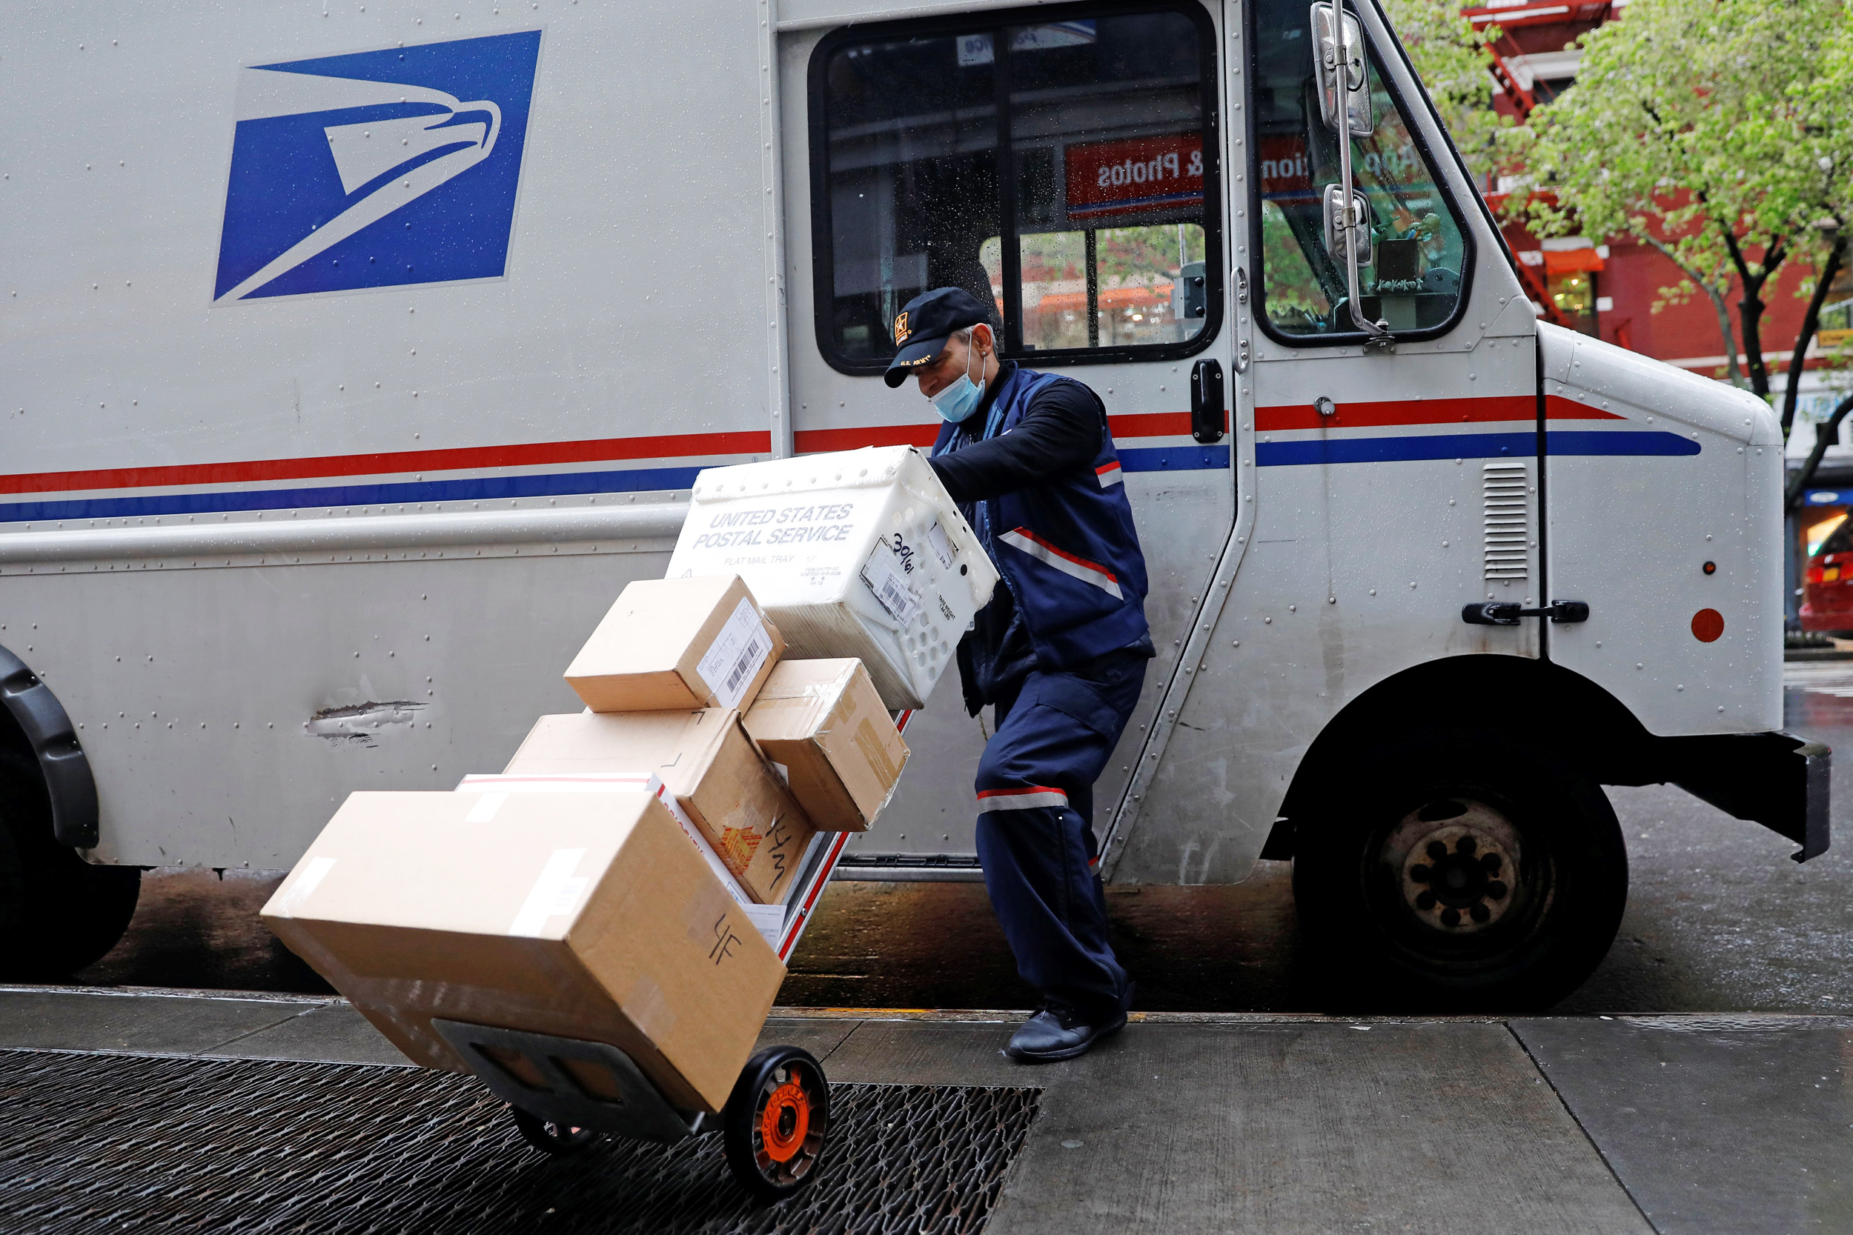
Jobs in My Town
Postal Worker
Notes:
This Job…
Travels around town
Delivers things to you house
Sorts letters and packages

Slide 12
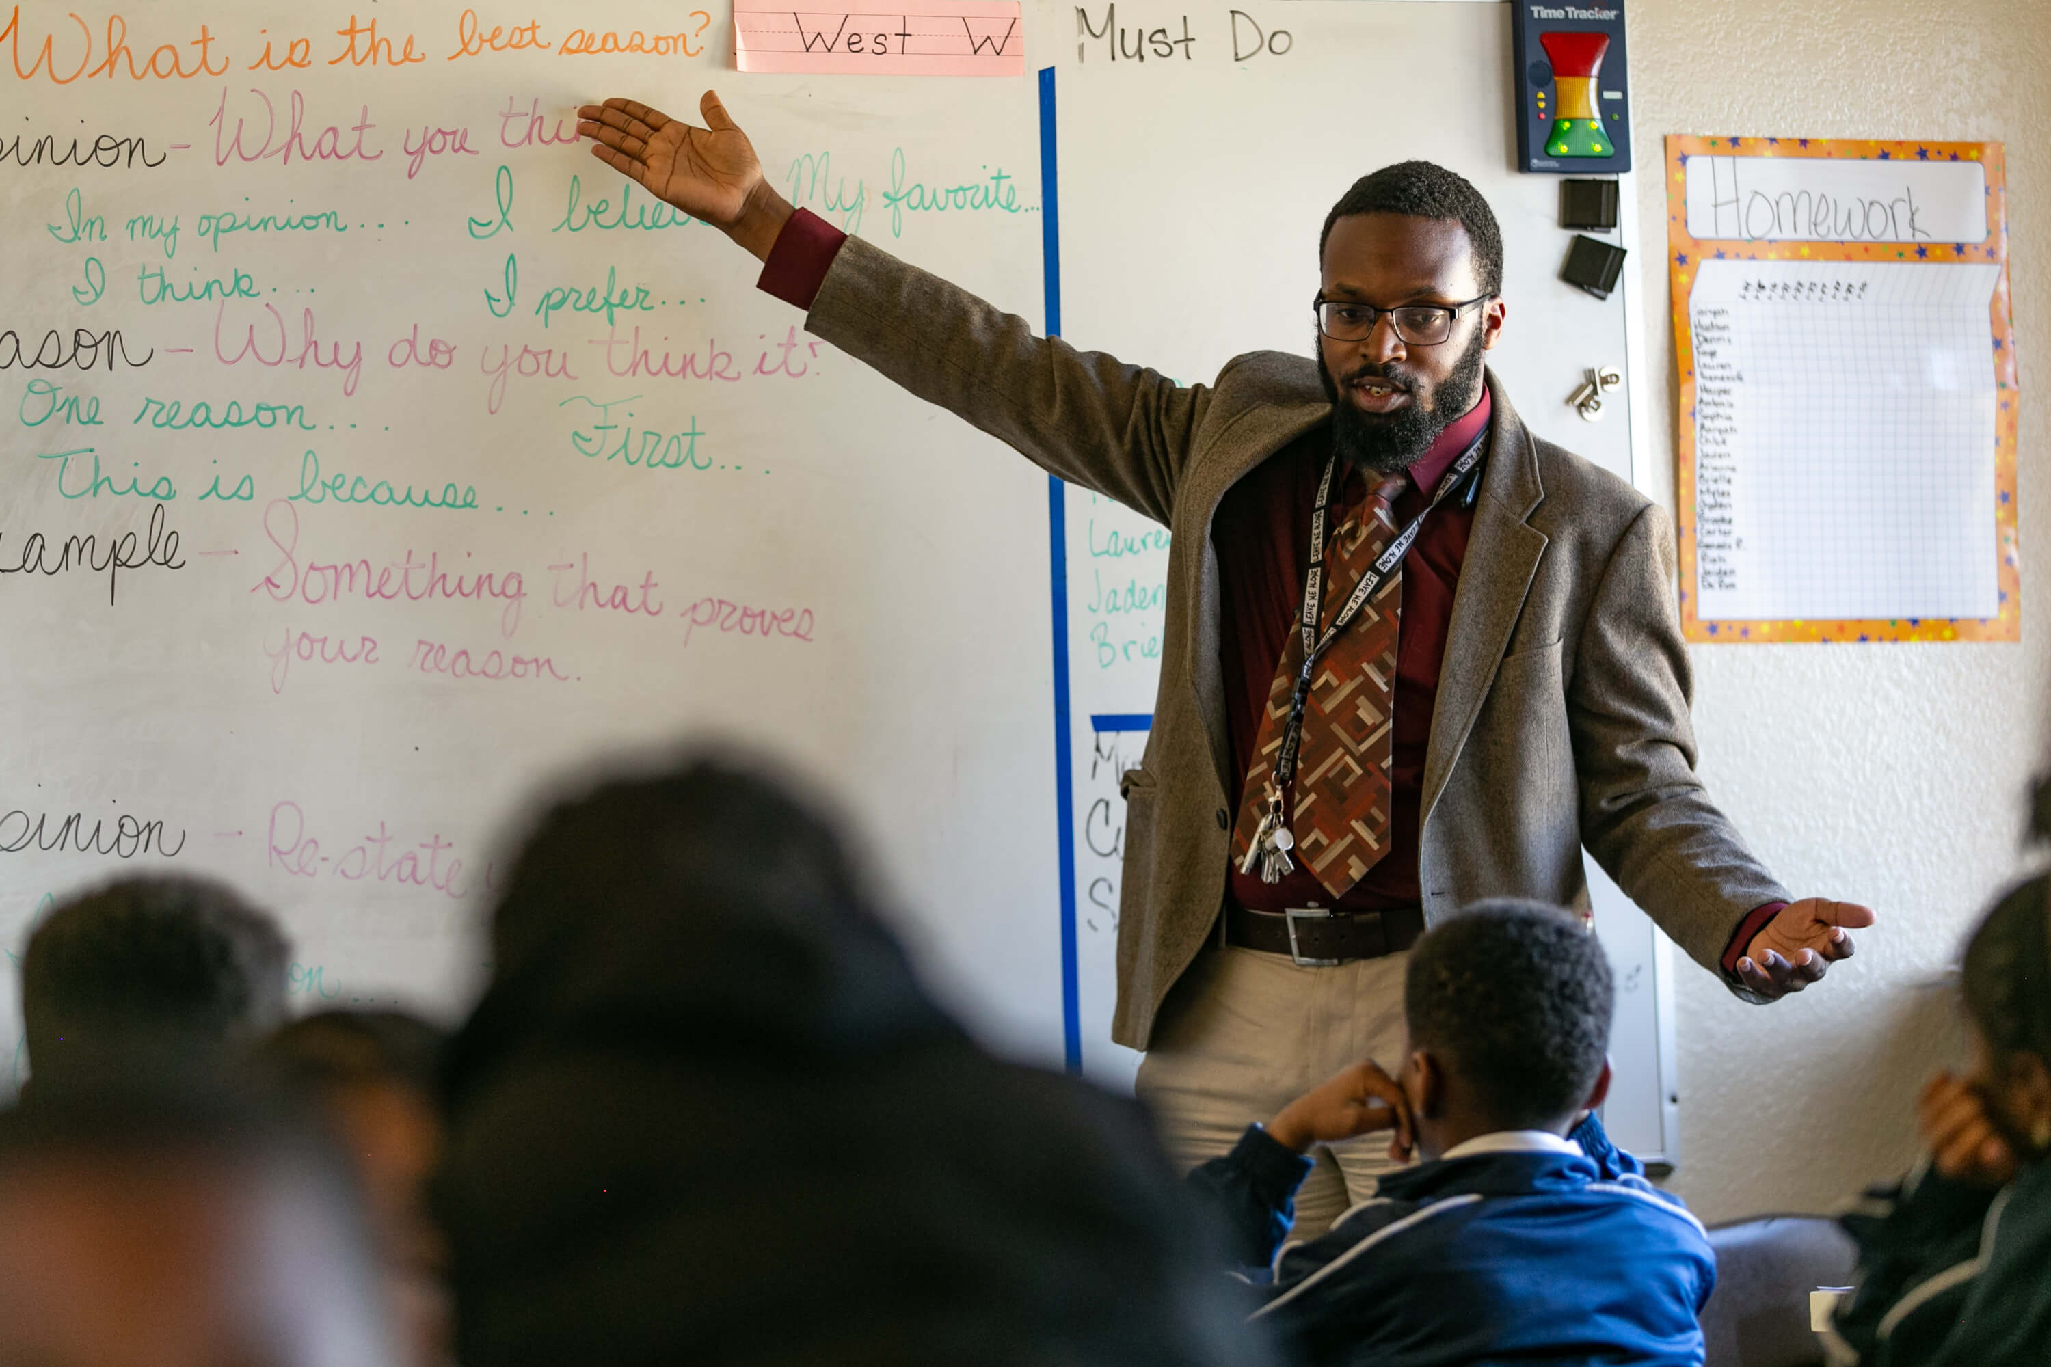
Jobs in My Town
Teacher
Notes:
This Job…
Works with books
Assigns Homework
Works with students just like you

